Slide 1
HW4 - Hypothesis Testing
Akshaj Kammari

Slide 2
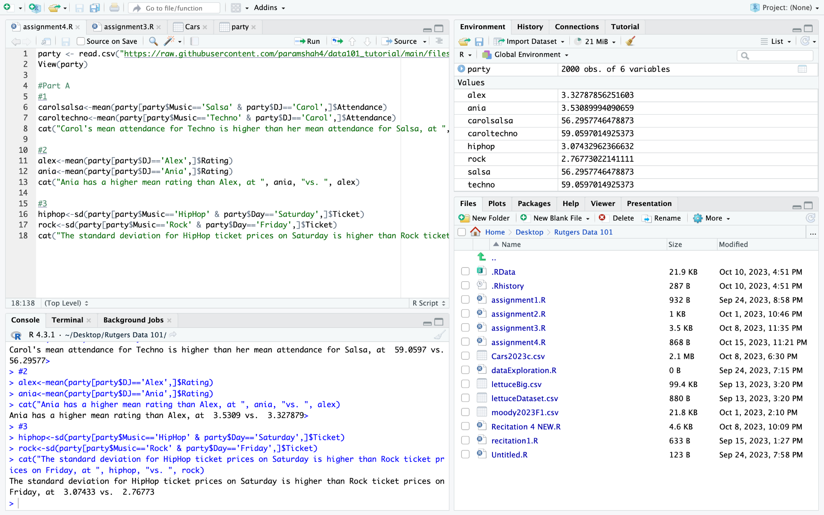
Part A

